Slide 1
HUMAN GAIT ANALYSIS

Slide 2
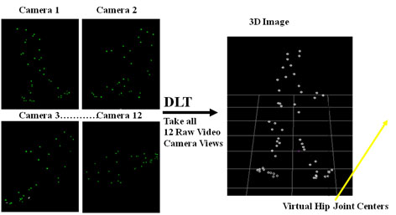
Introduction

Slide 3
Introduction
Gait analysis is a way to assess the dynamic posture and coordination during movement. This analysis is a means to evaluate, record, and make any necessary corrections for a smooth gait.
The gait analysis is modulated or modified by many factors, and changes in the normal gait pattern can be transient or permanent. The factors can be of various types:
Extrinsic: such as terrain, footwear, clothing, cargo
Intrinsic: sex, weight, height, age, etc.
Physical: such as weight, height, physique
Psychological: personality type, emotions
Physiological: anthropometric characteristics, i.e., measurements and proportions of body
Pathological: for example trauma, neurological diseases, musculoskeletal anomalies, psychiatric disorders

Slide 4
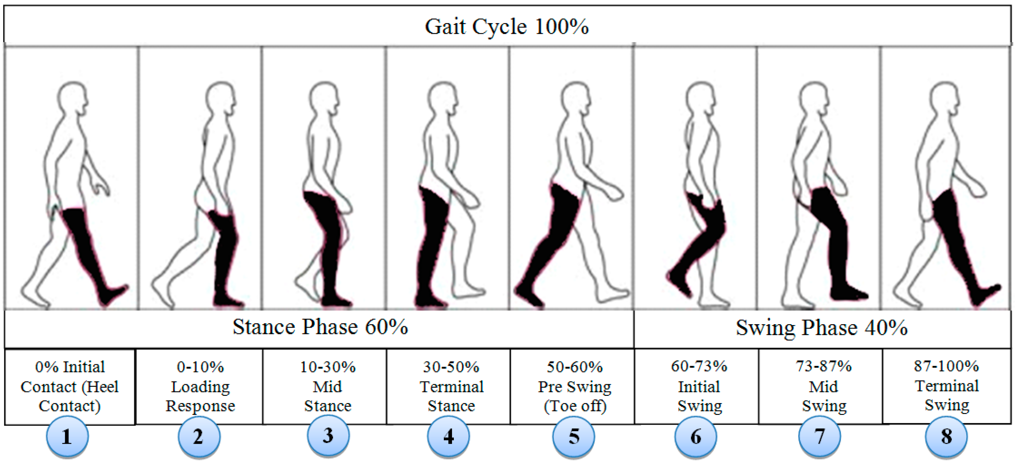
https://en.wikipedia.org/wiki/Gait_analysis#/media/File:Two_repetitions_of_a_walking_sequence_of_an_individual_recorded_using_a_motion-capture_system.gif

Slide 5
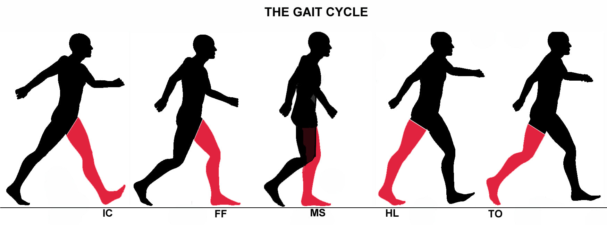
Parameters for Gait analysis
Step length
Stride length - stride length is the distance covered between the initial contact of your foot and the consecutive contact of that same foot
Cadence – no. of steps per minute
Speed
Dynamic base
Progression line
Foot angle
Hip angle
Squat performance

Slide 6
Techniques & Applications
Techniques
Temporal / spatial
Kinematics
Markerless gait capture
Pressure measurement
Kinetics
Dynamic electromyography
Applications
Medical diagnostics
Chiropractic and osteopathic uses
Comparative biomechanics
Gait as biometrics
Surveillance

Slide 7
For several decades human motion has been studied using conventional cinematography. Often the aim of this work has been to analyze human movements in the context of various sports—in particular, tracking the swing of a golf club and thus helping the player to improve his game.
To make the actions clearer, stroboscopic analysis coupled with bright markers attached to the body have been employed, and have resulted in highly effective action displays.
In the 1990s,machine vision was applied to the same task.
At this point the studies became much more serious and there was increased focus on accuracy.
The reason for this was a widening of the area of application not only to other sports but also to medical diagnosis and to animation for modern types of film containing artificial sequences.

Slide 8
Because high accuracy is needed for many of these purposes—not least measuring limps or other imperfections of human gait—analysis of the motion of the whole human body in normally lit scenes proved insufficient, and body markers remained important.
Typically, two are needed per limb, so that the 3-D orientation of each limb is deducible.
Some work has been done to analyze human motions using single cameras, but the majority of the work employs two or more cameras: multiple cameras are valuable because of the occlusion that occurs when one limb passes behind another, or behind the body.

Slide 9
To proceed with the analysis, a kinematic model of the human body is required. In general, such models assume that limbs are rigid links between a limited number of ball-and-socket joints, which can be approximated as point junctions between stick limbs.
For example, one such model (Ringer and Lazenby, 2000) employs two rotation parameters at the point where the hips join the backbone, three for the joint where the thigh bone joins the hips, plus one for the knee and another for the ankle.
Thus, each leg has seven degrees of freedom, two of these being common (at the backbone): this leads to a total of 12 parameters covering leg movements that the joints are basically rotational, though there is some slack in the system, especially in the shoulders, while the knees have some lateral freedom.
Finally, the whole situation is made more complex by constraints such as the inability of the knee to extend the lower leg too far forward

Slide 10
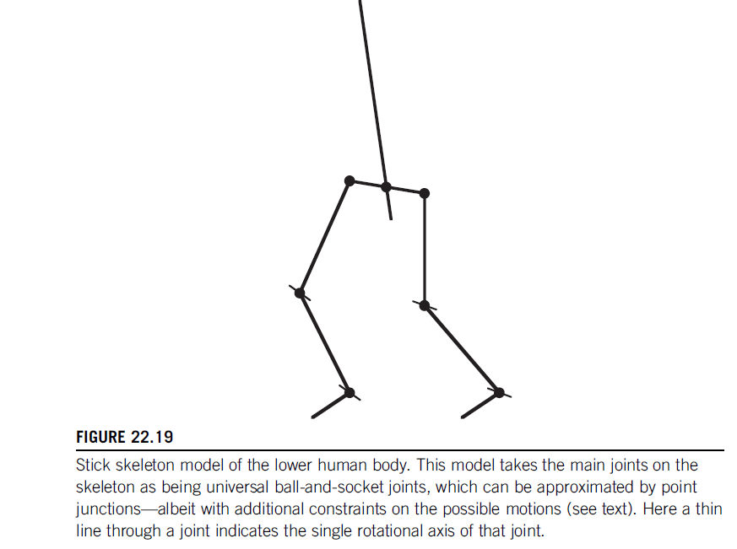

Slide 11
the frequency with which occlusions of parts of a leg or arm are bound to take place, special association algorithms are required for the purpose.
These include the Kalman filter that helps to predict how unseen markers will move
until they come back into view.
Such models can be improved by including acceleration parameters as well as position and velocity parameters (Dockstader and Tekalp, 2002). Their model is not merely theoretically deduced:.

Slide 12
it has to be trained, typically on sequences of 2500 images each separated by 1/30 s. In addition, the stick model of each human subject has to be initialized manually.
Considerable training is necessary to overcome the slight inaccuracies of measurement and to build up the statistics sufficiently for practical application when testing. Errors are greatest when measuring hand and arm movements, because of the frequent occlusions they are subject to

Slide 13
Overall, articulated motion analysis involves complex processing and a lot of training data. It is a key area of computer vision and the subject is evolving rapidly.
It has already reached the stage of producing useful output, but accuracy will improve over the next few years and this will set the scene for practical medical monitoring and diagnosis, completely natural animation, detailed help with sports activities at affordable costs, not to mention recognition of criminals by their characteristic gaits.

